Slide 1
Avoiding Common Pitfalls with Async/Await – Stephen Cleary
“This chapter tackles some challenging topics. You may not immediately understand everything. However, that is normal… Give yourself time. Let things rest. Reread some sections one or more days later.”
-Dr. Axel Rauschmayer, “Asynchronous JavaScript”
Notes:
Questions welcome!
Context: all .NET code. Many talks/blog posts assume either UI or ASP.NET context; we'll cover both.

Slide 2

Who is this guy?
Notes:
Most importantly: I don’t center my identity in being a developer. If AI takes my job, I’d be bummed but not devastated.
Microsoft MVP
Top async/await answerer on Stack Overflow
Assisted hundreds of companies with async adoption across all kinds of applications (available for contract work!)
Blog has been the go-to source for async advice for years
Contributor of some of the MS documentation on subjects such as ValueTask
Maintainer of AsyncEx, a library with >50M downloads which provides asynchronous coordination primitives and other async helper types

Slide 3


Slide 4
Async Syntax
Notes:
It’s 2025. People still don’t know how async/await works.
I even heard someone teach it wrong at a dev conference this year.

Slide 5
Async keyword: syntax
async Task DoNothingAsync()
{
// In the Real World, we would actually do something...
await Task.Delay(100);
}
The async keyword:
Enables the await keyword for that method.
Transforms the method into a state machine, similar to the yield keyword.
That’s it!
Notes:
The async keyword can only be applied to a method.

Slide 6
Async keyword: state machine
https://tinyurl.com/ycxnpskw
MoveNext() will be in your stack traces

Slide 7
Await keyword: awaitables
async Task DoNothingAsync()
{
// In the Real World, we would actually do something...
await Task.Delay(100);
}
async Task DoNothingAsync()
{
Task task = Task.Delay(100);
await task;
}
await
Takes a single argument.
Awaitable: Task/ValueTask (Future/Promise)
Notes:
“Await” is like a unary operator; it takes a single argument (like a cast). This argument is an “awaitable”.
An “awaitable” represents an asynchronous operation.
Technically, you don’t “await” a method; you call the method and then “await” the Task it returns. But “await a method” and “awaitable method” are common phrases.
- Another method can await the task returned from DoNothingAsync, not b/c the method is async, but b/c it returns a Task.
Async methods start synchronously; so this method will (synchronously) call Task.Delay and then await.
Await is where things can start to get asynchronous.

Slide 8
Await keyword: yielding execution
async Task DoNothingAsync()
{
// In the Real World, we would actually do something...
await Task.Delay(100);
}
If Task is complete, continues synchronously.
If Task is not complete, continues asynchronously:
Pauses the method and registers it with the task.
Then returns.
Notes:
The “registering” is saying, “when you complete, please resume this method” (using the state machine).
When DoNothingAsync returns, it returns an incomplete Task.
This Task is completed when the DoNothingAsync completes (end of method or “return” statement).

Slide 9
Await keyword: resuming execution
async Task DoNothingAsync()
{
// In the Real World, we would actually do something...
await Task.Delay(100);
}
Pausing and Resuming (when awaiting tasks)
Uses the state machine to resume at the right place.
Where to resume? UI, thread pool, etc.
Notes:
By default a context is captured: SynchronizationContext or TaskScheduler.
Usually a SynchronizationContext for UI apps (or old-school ASP.NET), or else the thread pool.

Slide 10
Conceptual Mistakes

Slide 11
Confusing Parallel and Async
Await does not mean “run on the thread pool”
Parallel throws more threads at the problem.
“There is no thread”
- Me, 2013
Notes:
In fact, async/await reduces the number of threads used in your application.
You can do both async and parallel, but realize they work in different ways!

Slide 12
Using Async to “go faster”
Client | Server
Primary benefit: Responsiveness | Primary benefit: Scalability
Keep UI thread free | Minimize threads used to serve requests
Better UX | 10x-100x scalability (same box)
Nonblocking UI is required by some app stores | Faster response to bursting traffic
Notes:
The benefits for client and server are different, but both come from the same core: freeing up threads. (Not using more threads).

Slide 13
Three Conceptual Models that won’t mislead you

Slide 14
Correctly conceptualizing Async (1)
“await”: “asynchronous wait”
Task represents the method’s execution.
Completion
Results
Exceptions
await can pause a method’s execution.
Notes:
This is my default conceptualization, and the one I describe when first teaching async/await.

Slide 15
Correctly conceptualizing Async (2)
Types: “wapper” / “unwrapper”
Task<T> wraps the result of an async method Task<T> is a future value of T async “wraps” future values into Task<T> await “unwraps” the future value from the task
(hint: async is a monad in functional languages)
Notes:
This conceptualization is useful when you are doing something functional and you need to figure out your types.
“I have a Task<string>. How do I get the string out of it?”

Slide 16
Correctly conceptualizing Async (3)
Callbacks
async chops up the method into a state machine, similar to the yield keyword
await identifies the dividing points where the method is chopped up
When await yields, it registers the next method chunk as a callback on the task
At runtime, the code stack inverts!
Call stack is not where your code came from; it’s where it’s returning to!
(and this is how the GC isn’t confused)
Notes:
This conceptualization is how async actually works, and explains how the GC works with async and why your call stack is “reversed”.

Slide 17
Task is an object
Task is not magic.
You can save it in a variable and await it later.
You can combine it naturally with other objects:
List<Task> (but beware IEnumerable<Task>)
Func<Task>
Lazy<Task>

Slide 18

Demotime!

Slide 19
Usage Mistakes

Slide 20
Avoid Async Void –Me, 2013
void is not a natural type for async methods:
Doesn’t represent execution.
No way to detect completion (shutdown, results).
Awkward error handling (no try/catch).
Doesn’t exist in other async/await languages.
Primary purpose: async event handlers.
Notes:
Async void is occasionally useful elsewhere, like processing loops in pipelines.

Slide 21
Blocking on Async Code
Can cause deadlocks
https://tinyurl.com/AsyncAllTheWay
When await pauses a method, it captures a context (SynchronizationContext / TaskScheduler), and resumes the method in that context.
Some contexts only allow one thread at a time.
Thread pool exhaustion
Blocking on async code uses a thread pool thread and then requires another thread pool thread to unblock!

Slide 22
Mistakes!
Fire and forget
Side effects instead of returning results
ContinueWith, StartNew, Task constructor
Eliding async/await in non-trivial methods
WaitAsync(token) to “cancel” a task
Using ConfigureAwait(false) to avoid deadlocks
WhenAny + Remove
Async events: Strategy vs Observer
Fake async methods

Slide 23
Adding unnecessary callbacks
Old code:
void DoSomething(Action onComplete) { …; onComplete(); } A(); DoSomething(() => B());
New code:
Task DoSomethingAsync() { …; } A(); await DoSomething(); B();

Slide 24
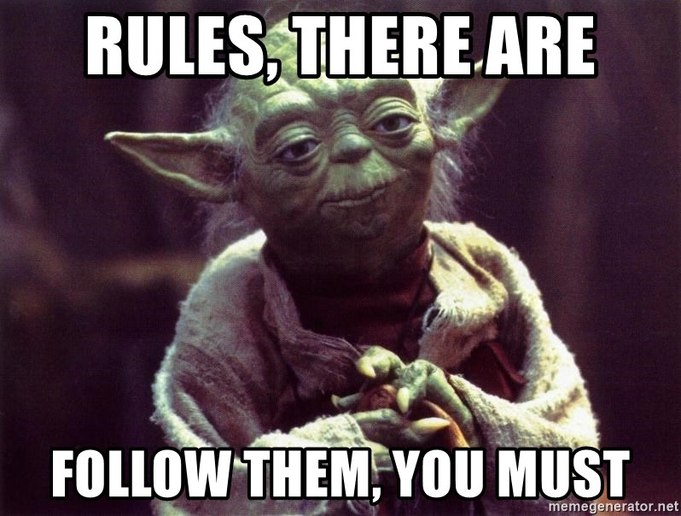
Rules Around ValueTask
Only consume once!
await – the 99% case.
Advanced: IsCompleted for fast path.
Cannot block!
.Result and .GetAwaiter().GetResult() will compile but may fail at runtime.
Even worse, they may work at runtime (block) and then later fail at runtime.
Need to bend the rules? AsTask()

Slide 25
Not Invented Here (actually more like “I didn’t know!”)

Slide 26
Cancellation
CancellationTokenSource – controls a CancellationToken
CancellationToken – used to detect cancellation.
ThrowIfCancellationRequested
Register(delegate)
Seldom used directly.
Notes:
Usually, just pass CancellationToken to next method in the chain.

Slide 27
Progress Reporting
IProgress<T> - a “sink” for progress updates.
Progress<T> - built-in implementation.
Others, too!
Your own. E.g., for throttling UI updates.
Notes:
Each progress update is of type T.
The built-in implementation is great for UI but isn’t intended to be used everywhere.

Slide 28
Pipelines (ETL)
Use System.Threading.Channels if possible.
(Use TPL Dataflow if you need all the bells and whistles).

Slide 29
Demotime!
Notes:
Cancellation / Progress Reporting
Pipelines

Slide 30

Q&A
Go forth and be awesome!
Image from Etsy user Rosewine; used with permission

